Slide 1
2021
Annual Competition
The Finals
Best Bronze Image
Best Projected Image

Slide 2
Best bronze image
Bronze cup

Slide 3
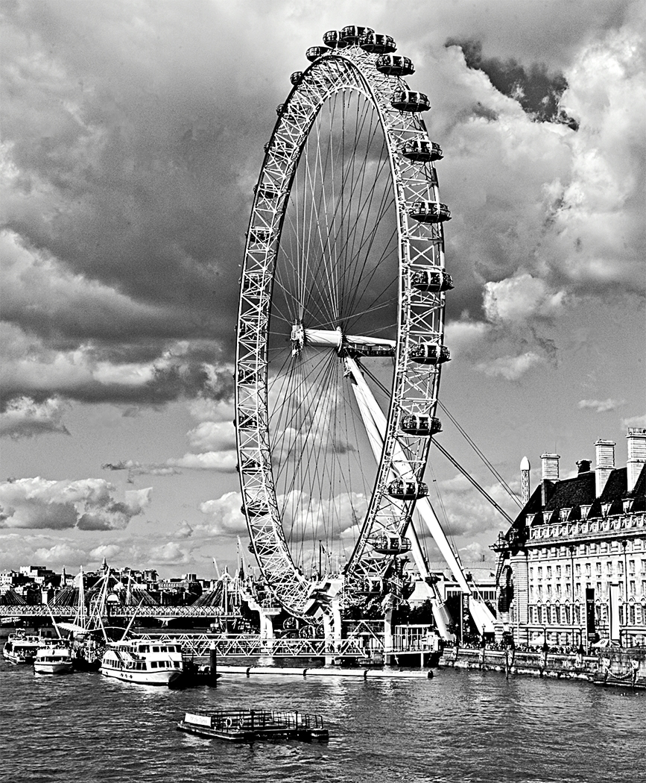
David Greenwood
#1
LONDON EYE
(Pictorial Monochrome)

Slide 4
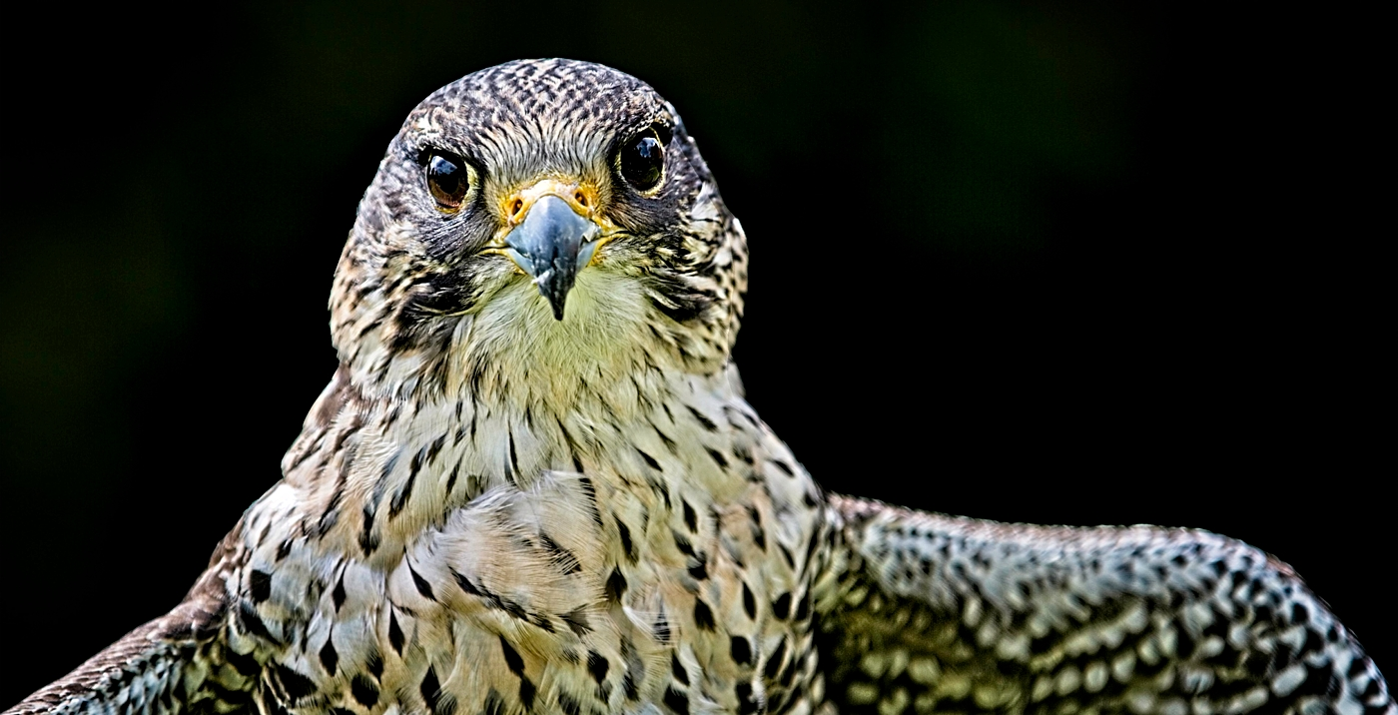
David Greenwood
#2
GOSHAWK
(Wildlife)

Slide 5
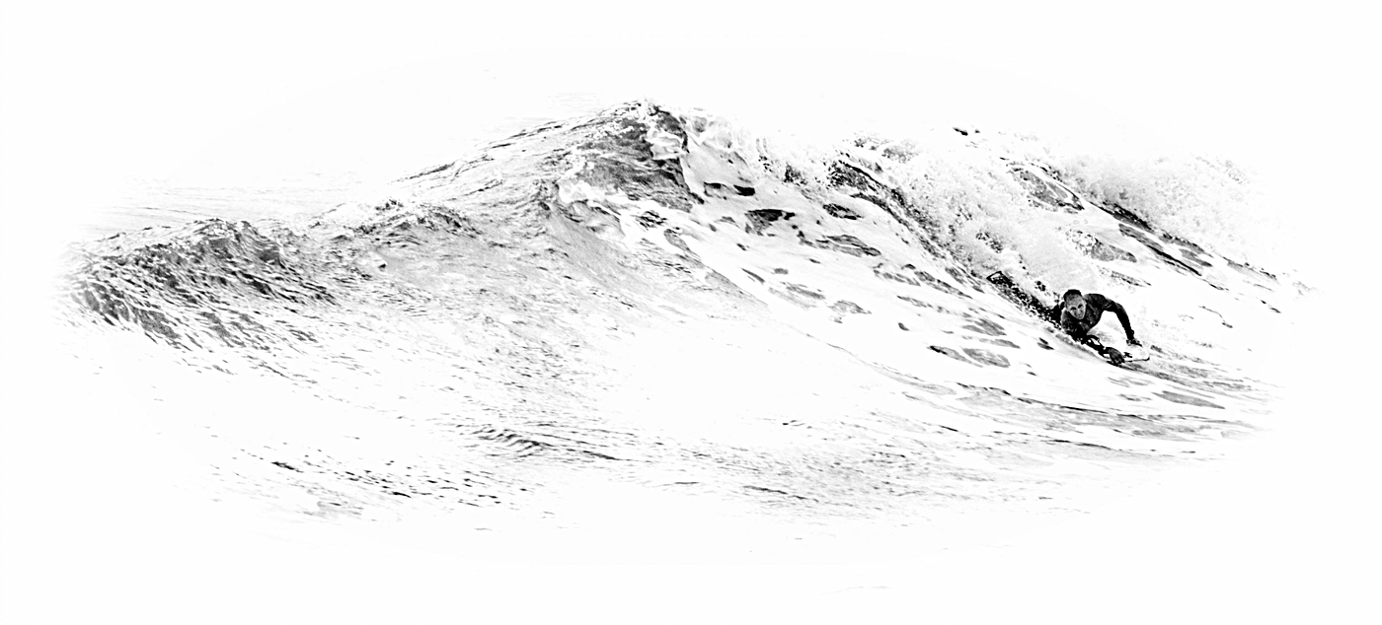
David Greenwood
#3
BODY SURFER
(Candid, Action, Decisive Moment, Street Photography)

Slide 6
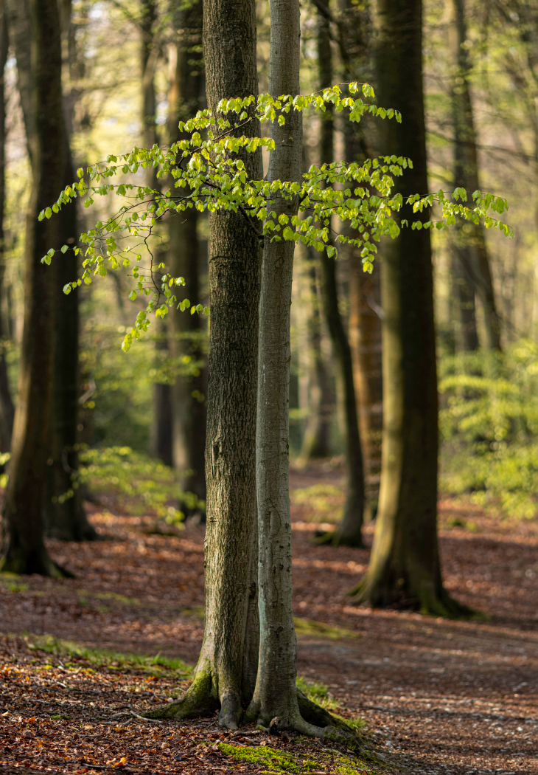
Paul Goby
#4
BEECH LEAVES IN THE SPRING
(Landscape)

Slide 7
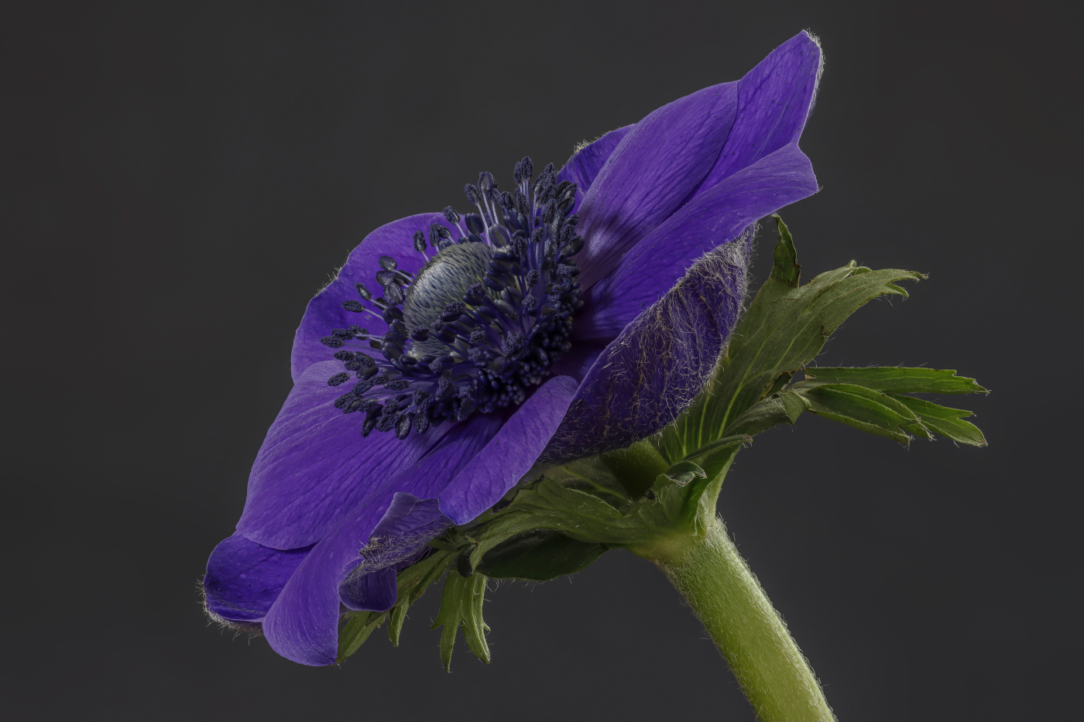
Paul Goby
#5
BLUE ANEMONE
(Cultivated Flowers / Plants)

Slide 8
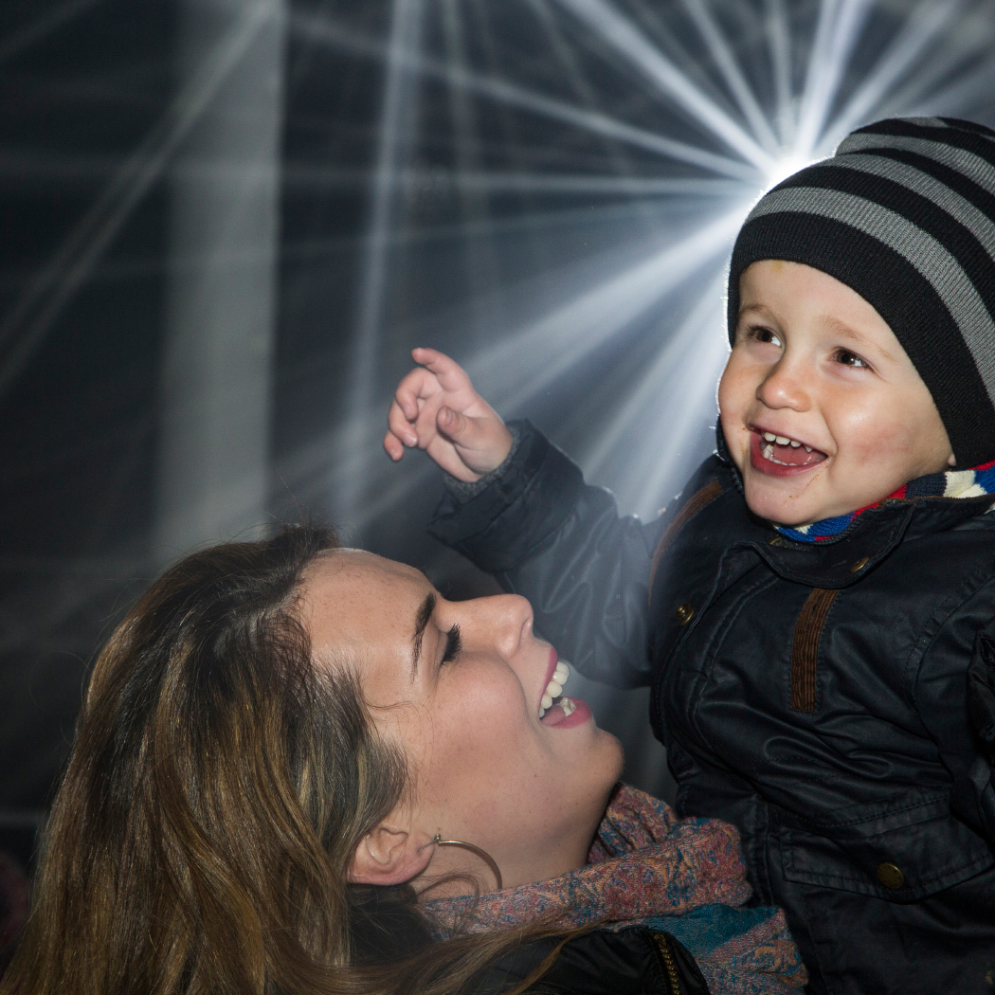
Paul Goby
#6
IMI AND THEO CHRISTMAS LIGHTS
(Candid, Action, Decisive Moment, Street Photography)

Slide 9
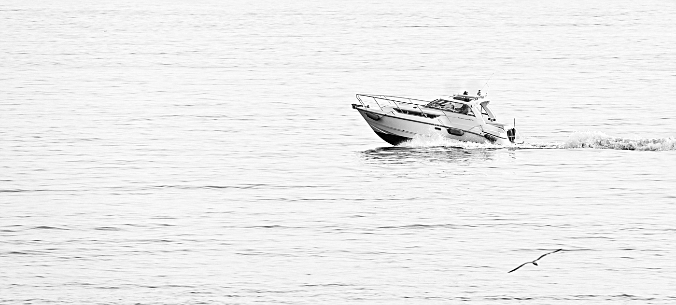
David Greenwood
#7
HAVING FUN
(Pictorial Monochrome)

Slide 10
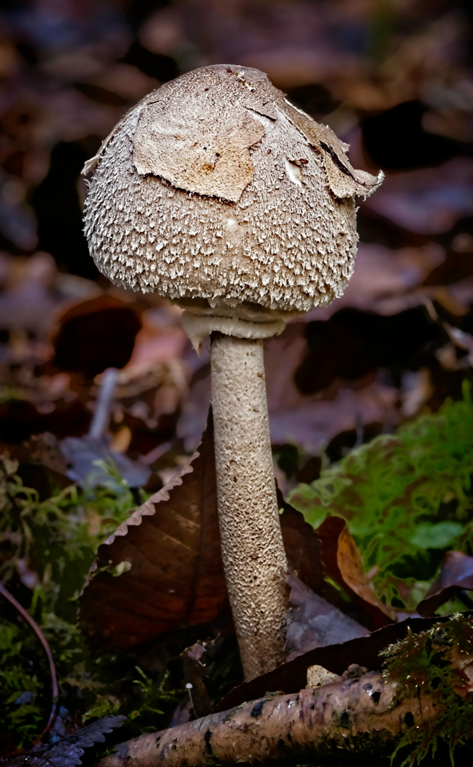
David Greenwood
#8
FUNGUS
(Pictorial Colour)

Slide 11
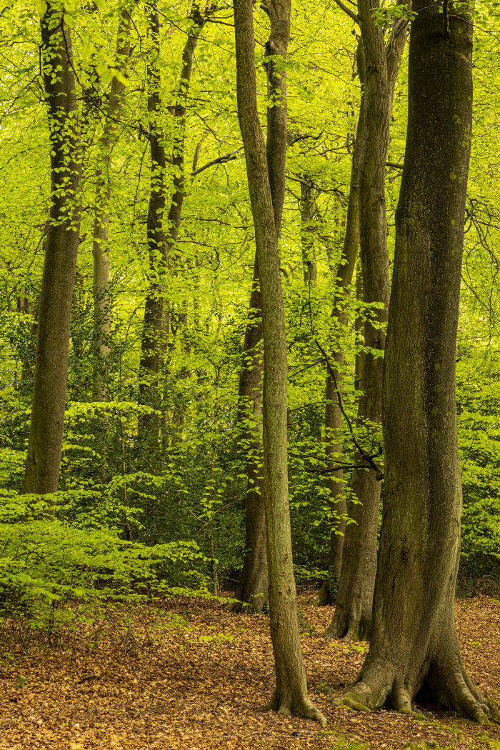
Paul Goby
#9
SUNNY SPRING BEECHES
(Landscape)

Slide 12
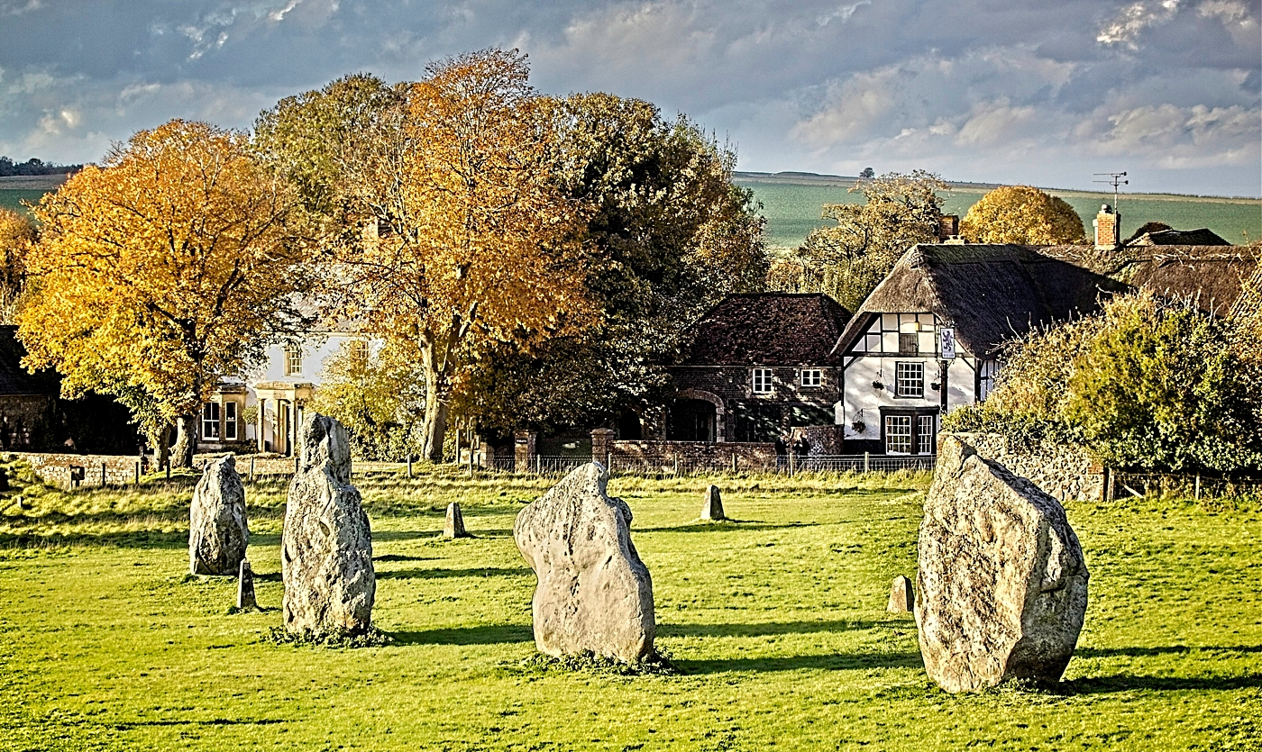
David Greenwood
#10
AVEBURY AND RING
(Landscape)

Slide 13
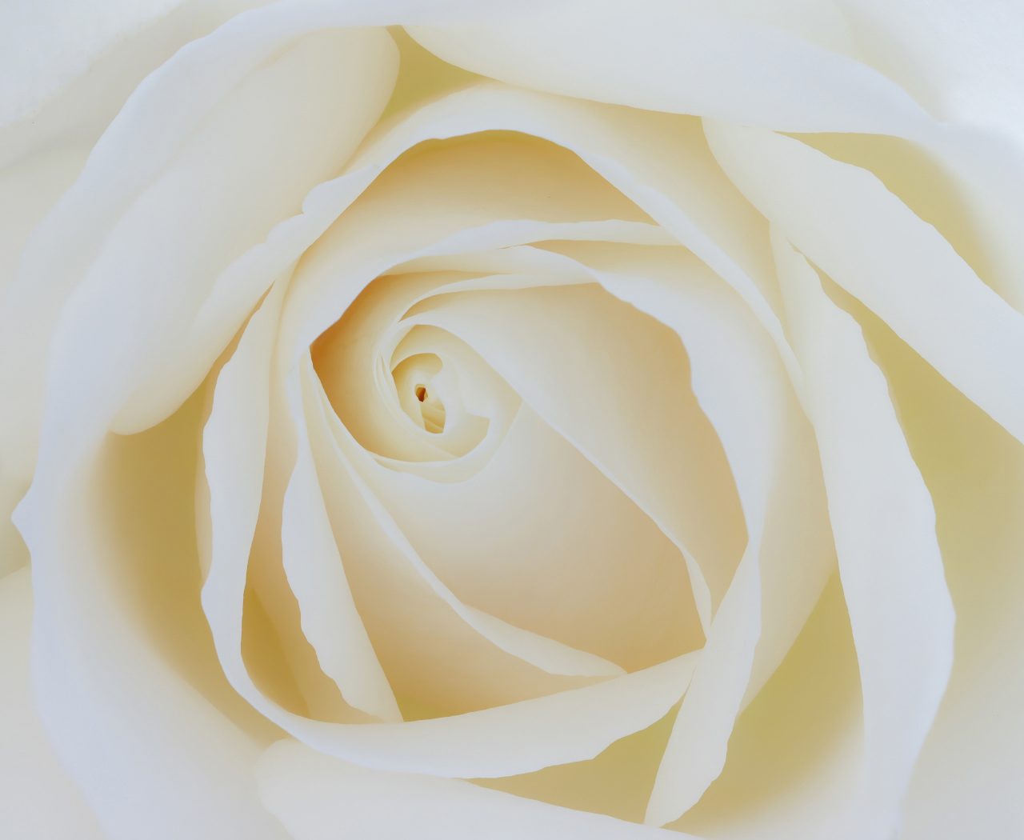
Paul Goby
#11
WHITE ROSE
(Cultivated Flowers / Plants)

Slide 14
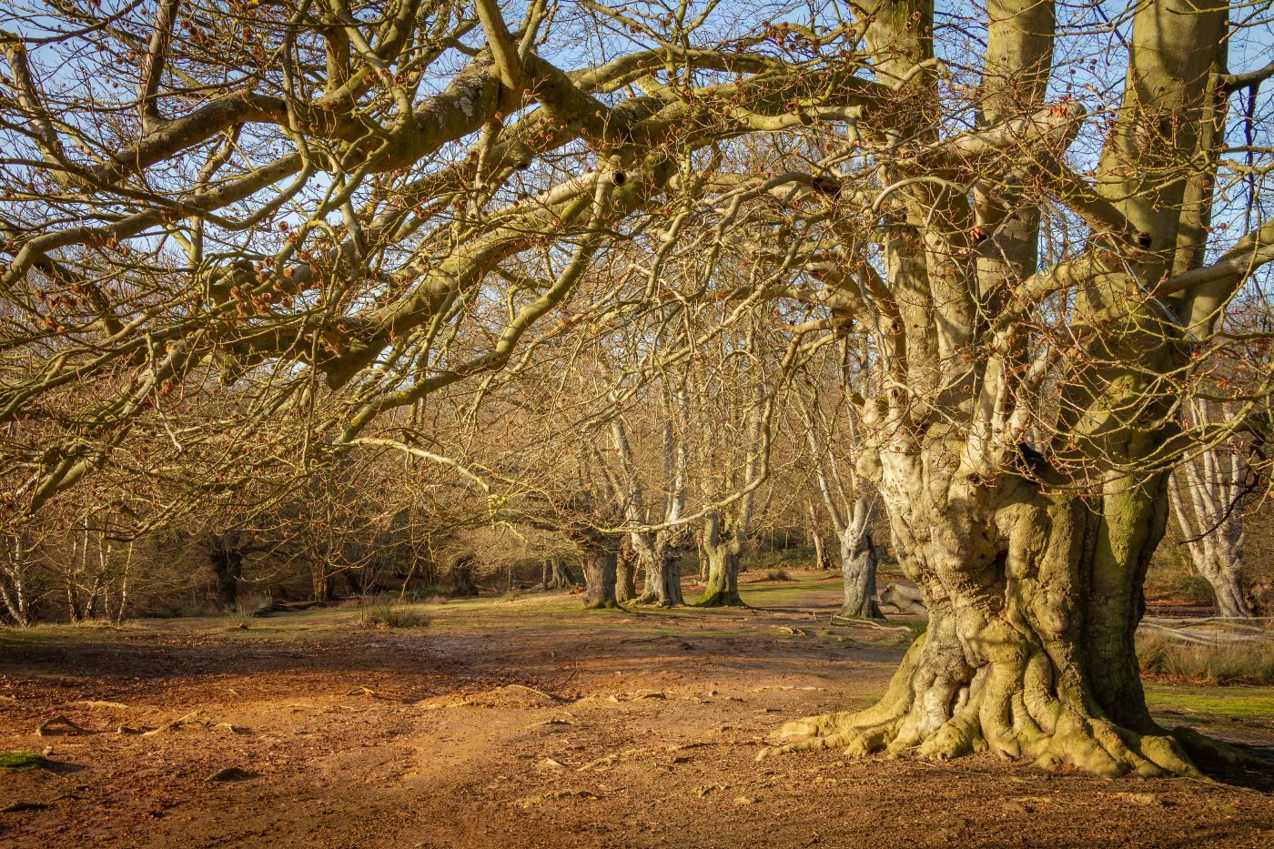
Paul Goby
#12
ANCIENT BEECHES
(Landscape)

Slide 15
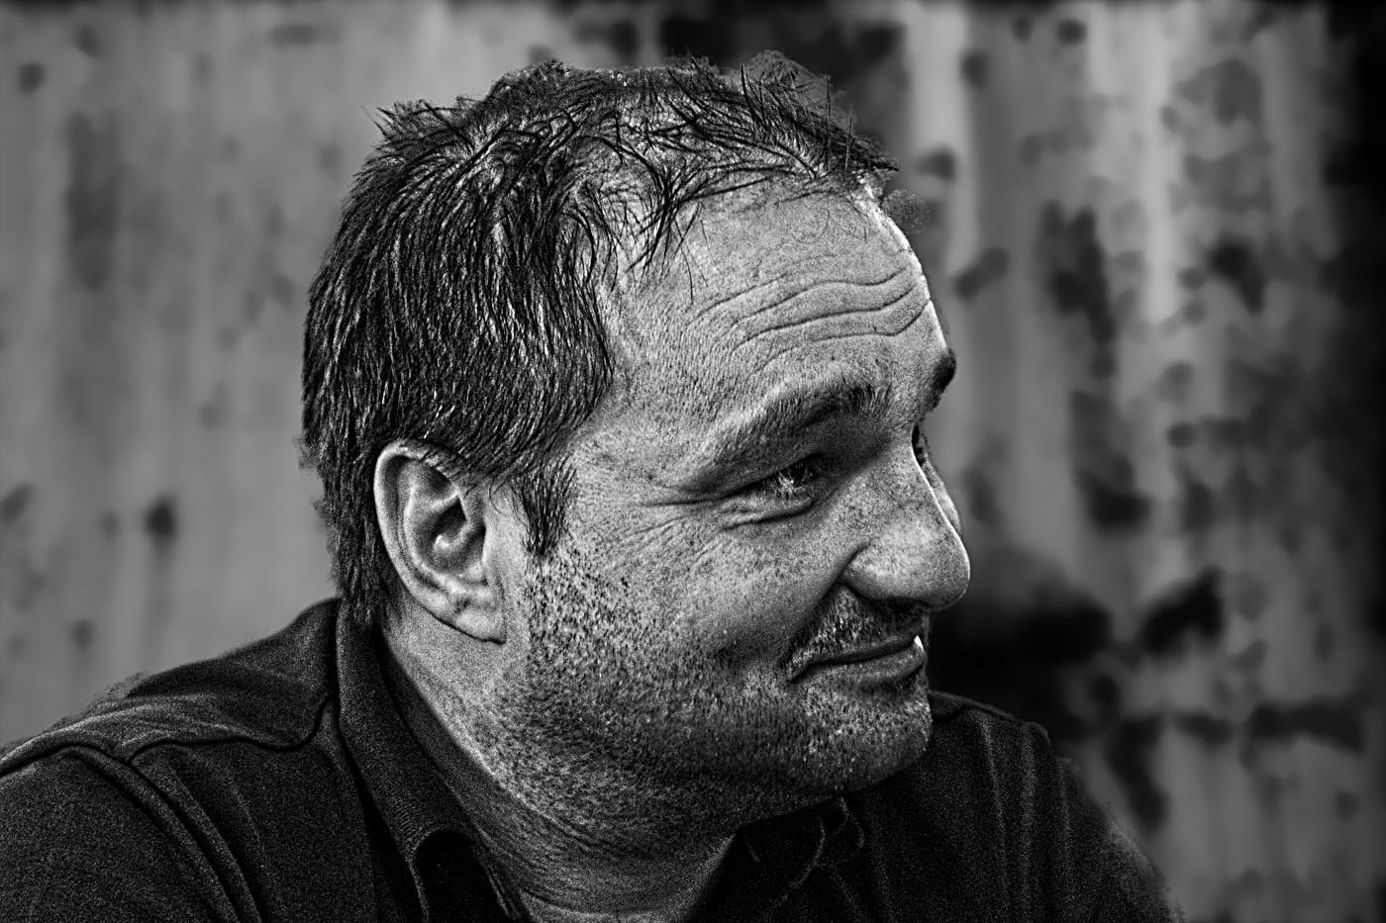
David Greenwood
#13
MARIO
(People and Portraits)

Slide 16
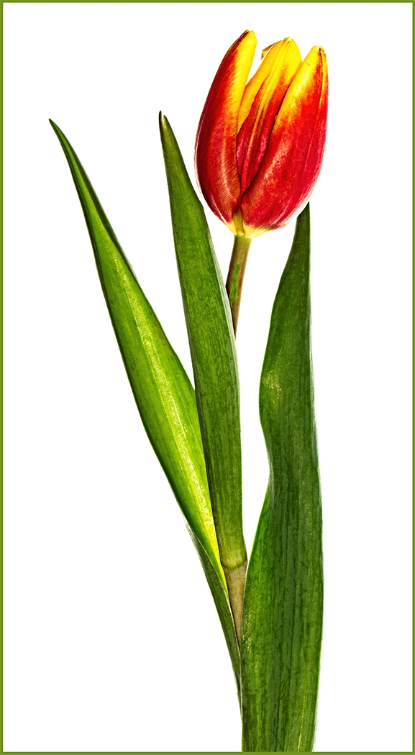
David Greenwood
#14
TULIP
(Cultivated Flowers / Plants)

Slide 17
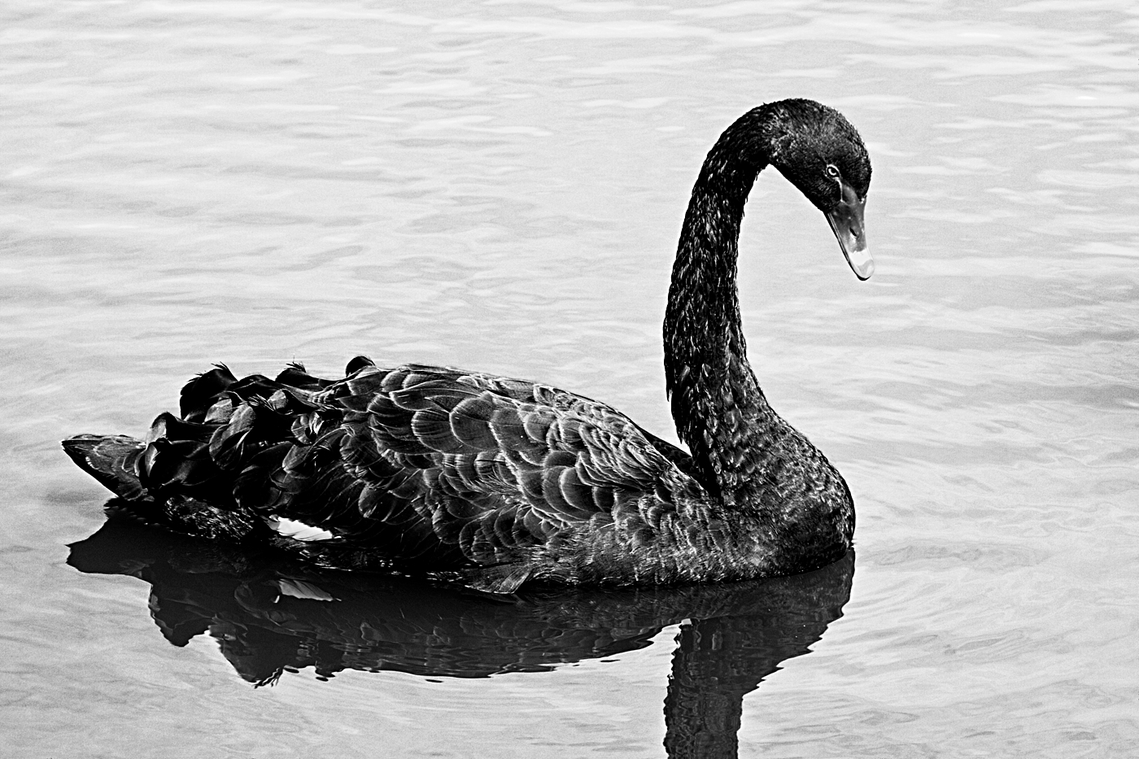
David Greenwood
#15
BLACK SWAN
(Wildlife)

Slide 18
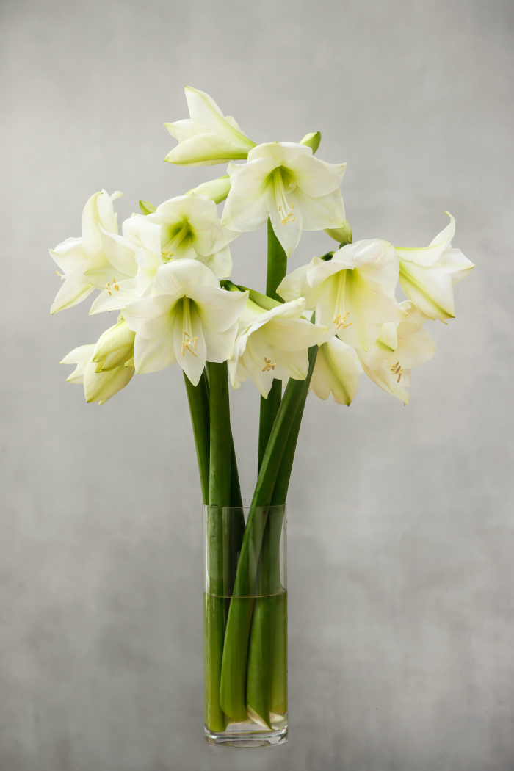
Paul Goby
#16
WHITE AMARYLIS
(Cultivated Flowers / Plants)

Slide 19
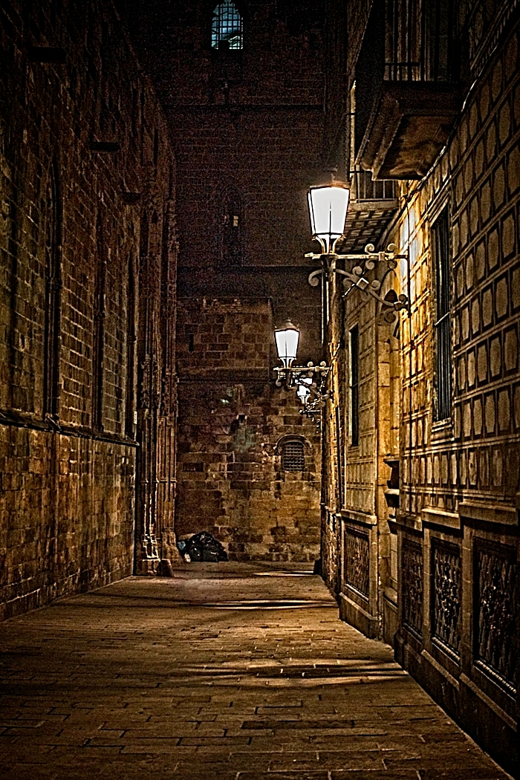
David Greenwood
#17
ALLEYWAY BEHIND BARCELONA CATHEDRAL
(Foreign Travel)

Slide 20
Commended
#1 EARLY MORNING ROW

Slide 21
Paul Goby
#5
BLUE ANEMONE
(Cultivated Flowers / Plants)

Slide 22
Highly Commended
#1 EARLY MORNING ROW

Slide 23
Paul Goby
#6
IMI AND THEO CHRISTMAS LIGHTS
(Candid, Action, Decisive Moment, Street Photography)

Slide 24
Winner of the
Bronze cup
#1 EARLY MORNING ROW

Slide 25
David Greenwood
#8
FUNGUS
(Pictorial Colour)

Slide 26
Congratulations
To the following
Highly commended & commended
Best Bronze Image:
Highly Commended – Paul Goby – IMI AND THEO CHRISTMAS LIGHTS
(Candid, Action, Decisive Moment, Street Photography)
Commended – Paul Goby – BLUE ANEMONE (Cultivated Flowers / Plants)

Slide 27
Best Projected digital image
Jack Wilson cup

Slide 28
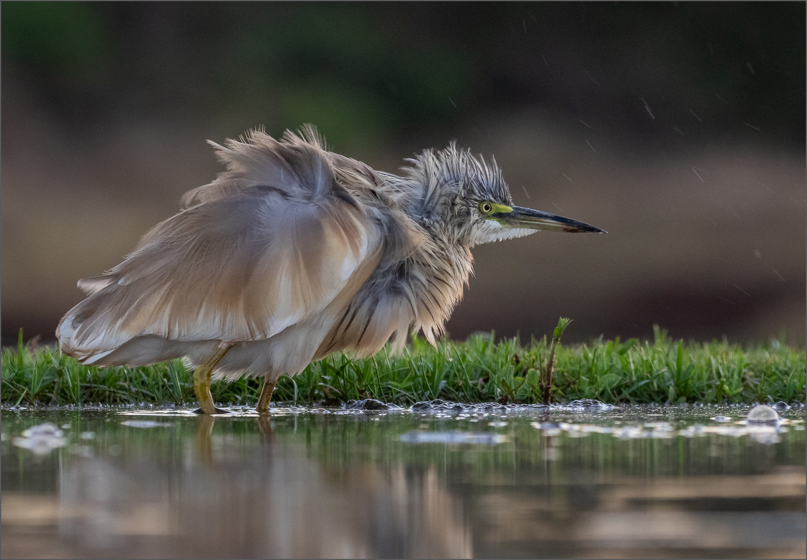
Teresa Hehir CPAGB
#1
SQUACCO HERON
#1 EARLY MORNING ROW

Slide 29
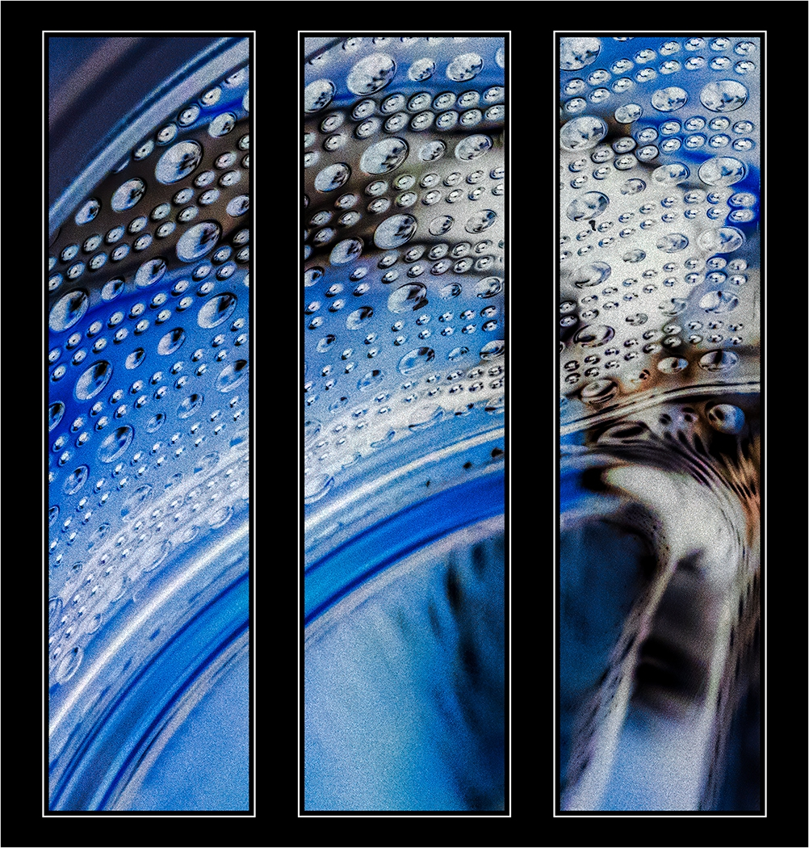
Hilary Pickersgill
#2
BLUE WAVE
#1 EARLY MORNING ROW

Slide 30
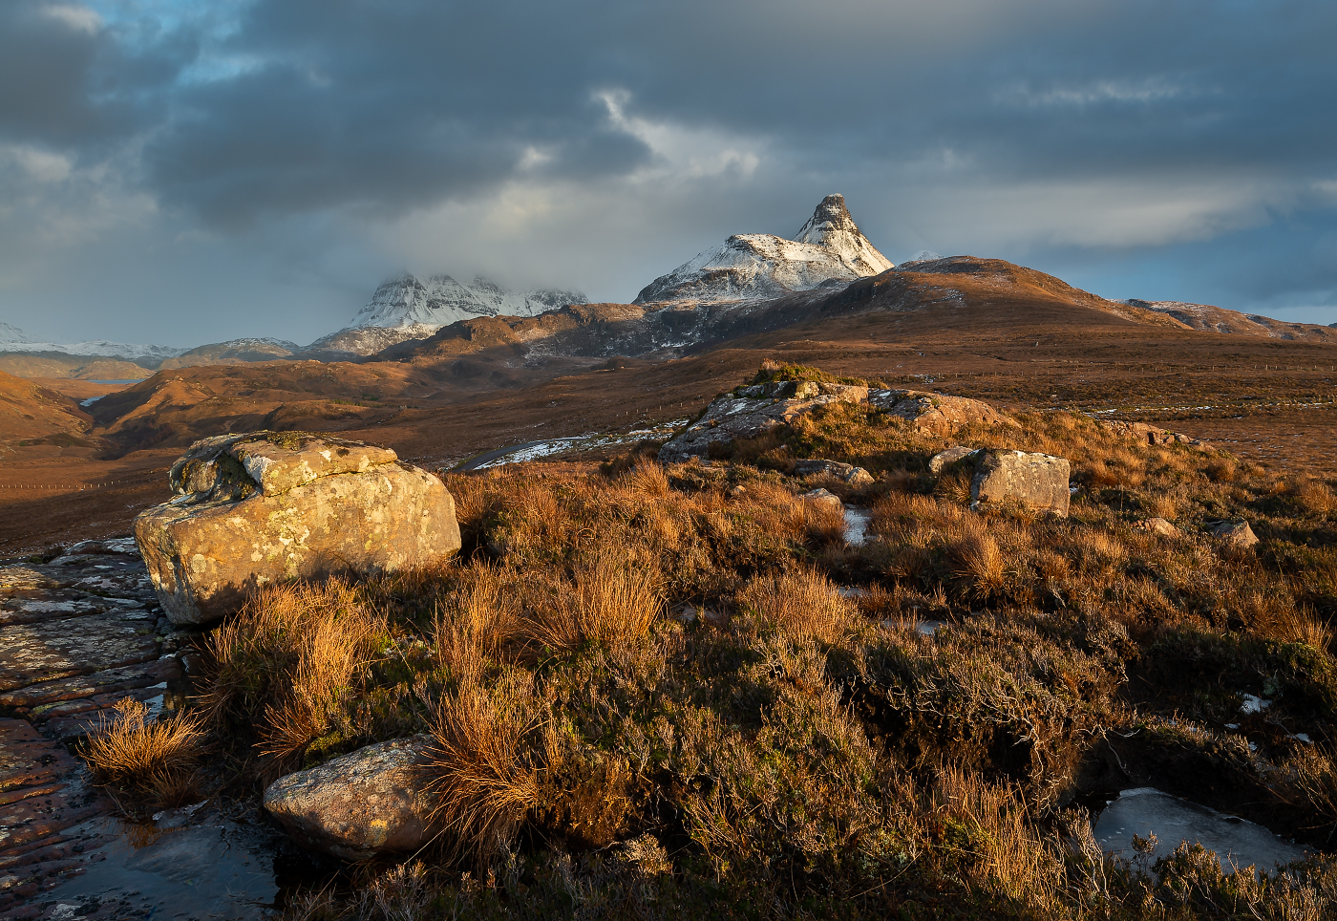
Jan Harris ARPS, CPAGB
#3
WINTER IN ASSYNT

Slide 31
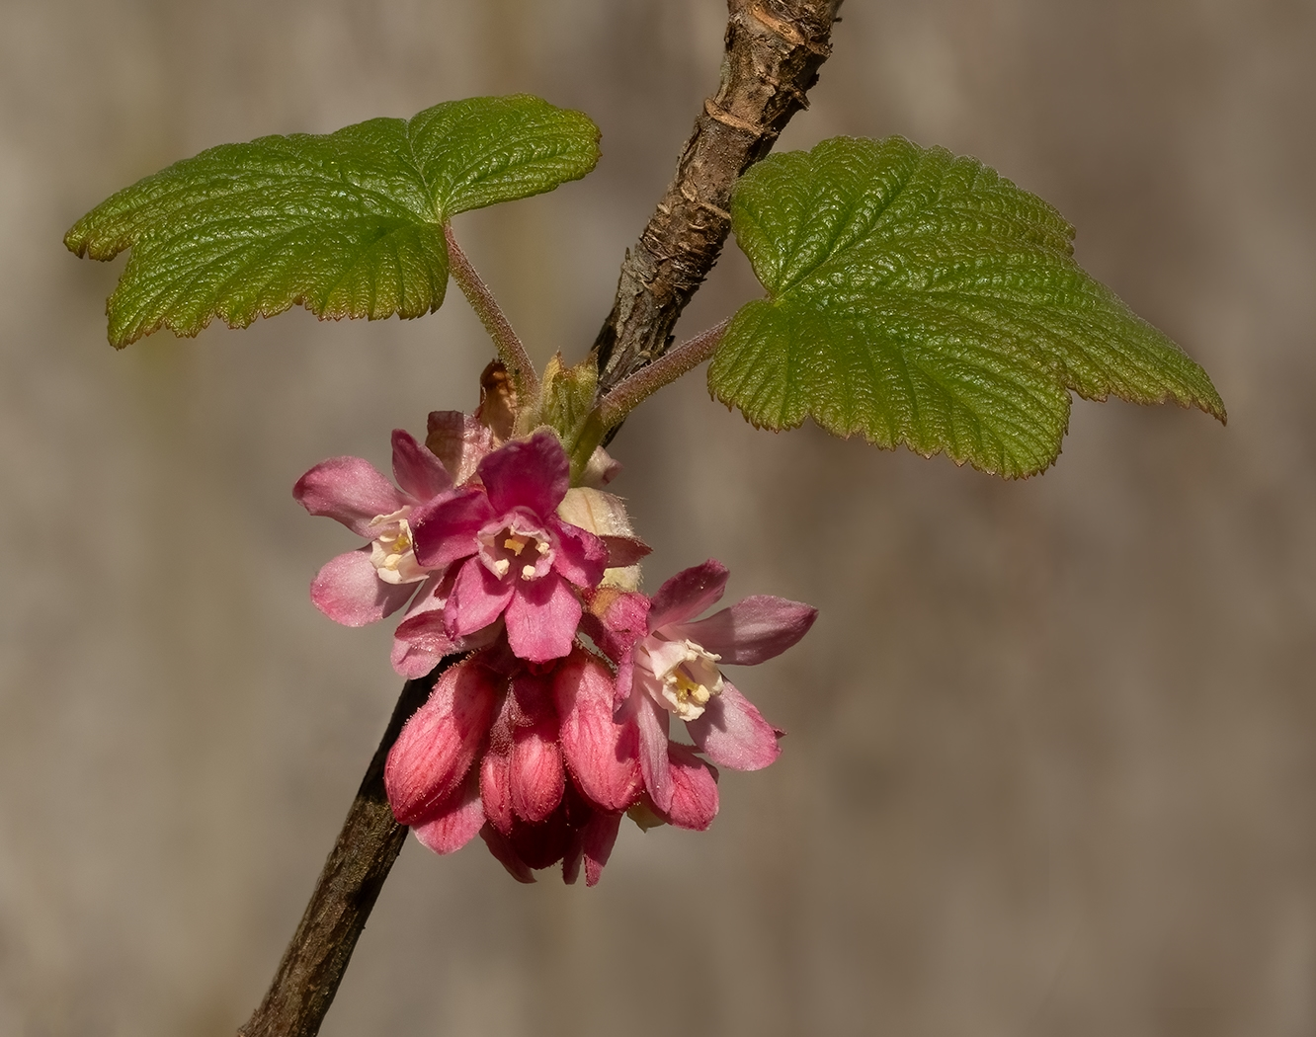
Hilary Pickersgill
#4
FLOWERING CURRANT

Slide 32
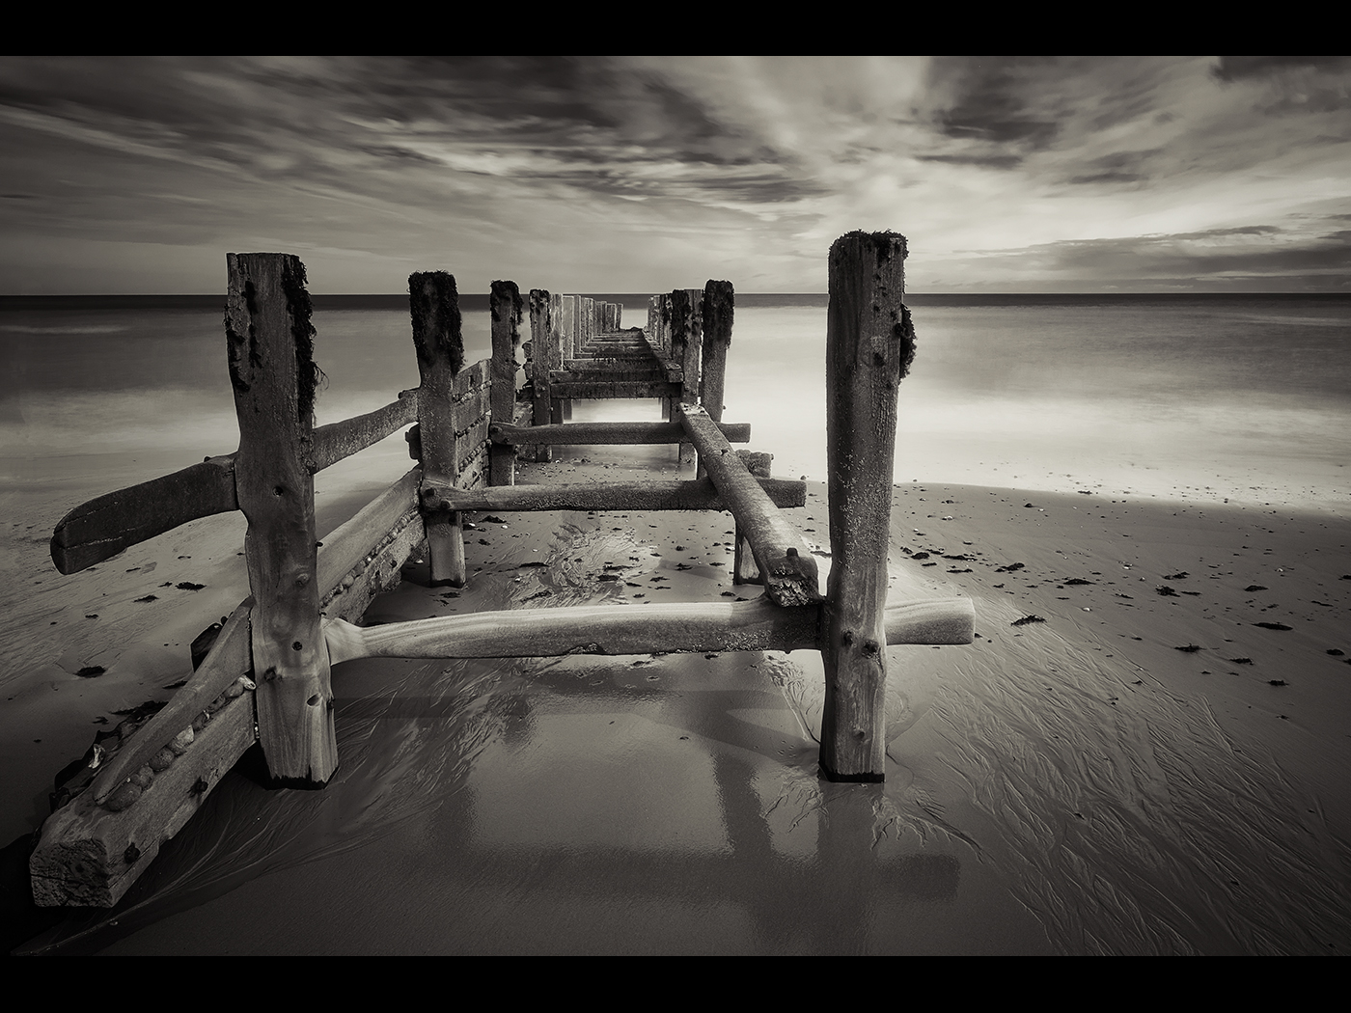
Allan Marshall
#5
OLD GROYNES

Slide 33
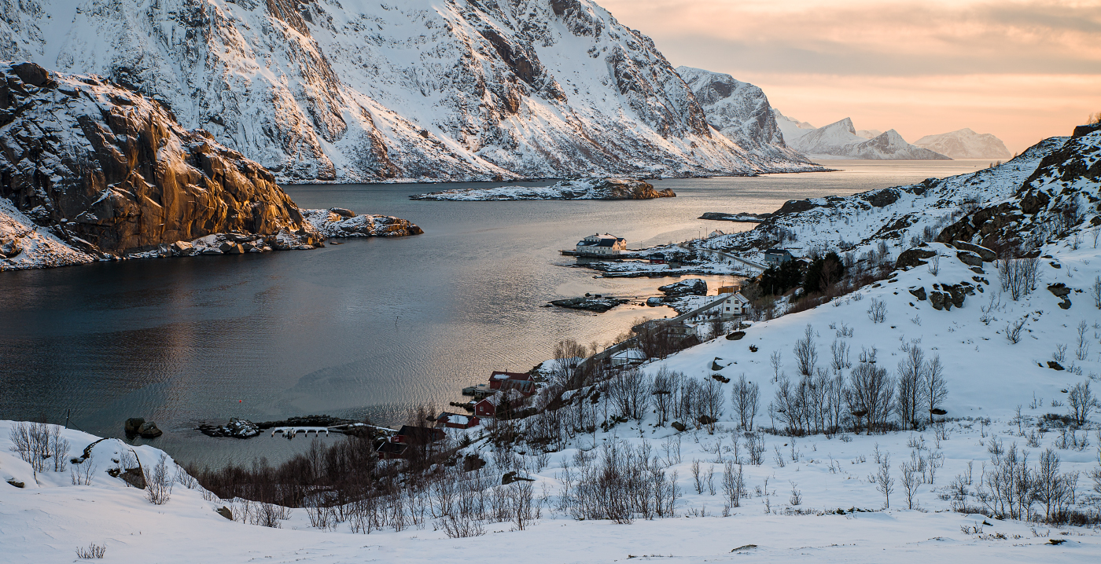
David Harris ARPS, CPAGB #6 BORSTAD WINTER SUNSET

Slide 34
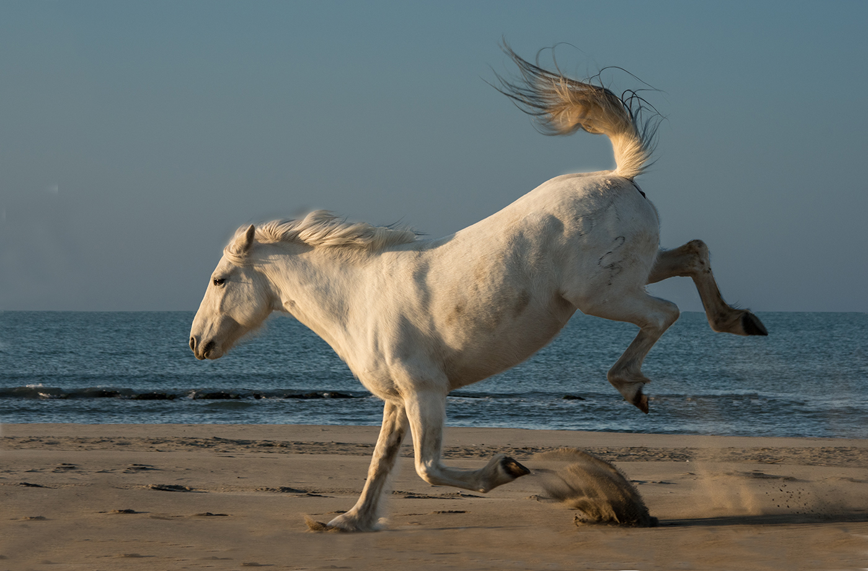
Pat Begley
#7
BUCKING HORSE

Slide 35
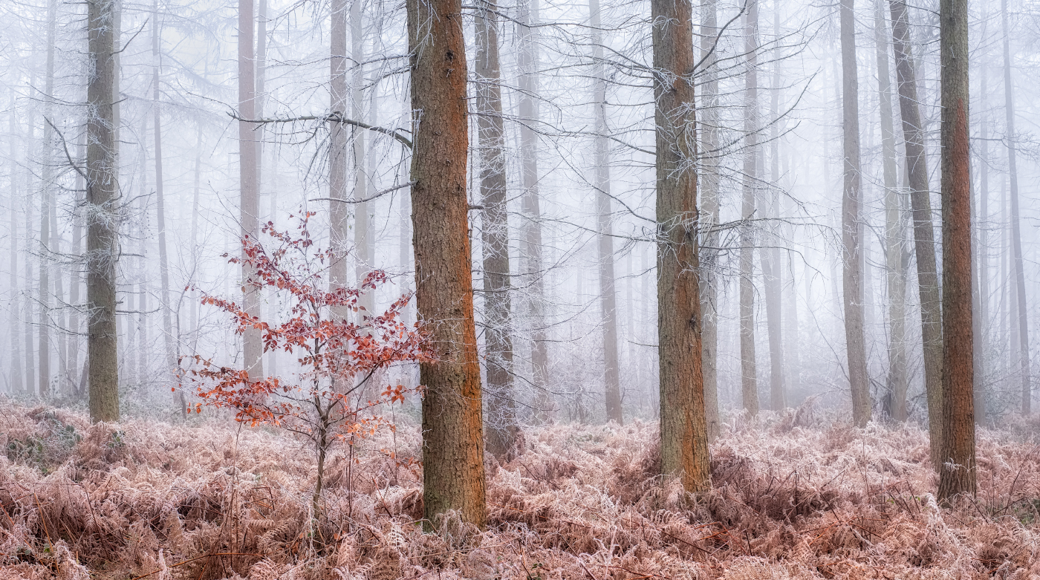
David Harris ARPS, CPAGB #8 IN A LAND OF GIANTS

Slide 36
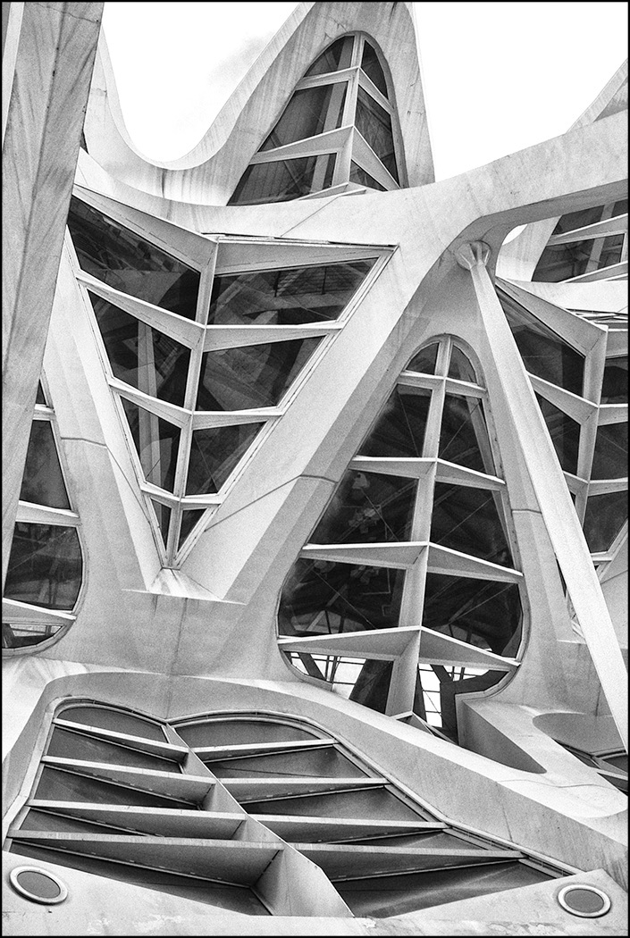
Carole Dixon
#9
VERTIGINOUS LINES

Slide 37
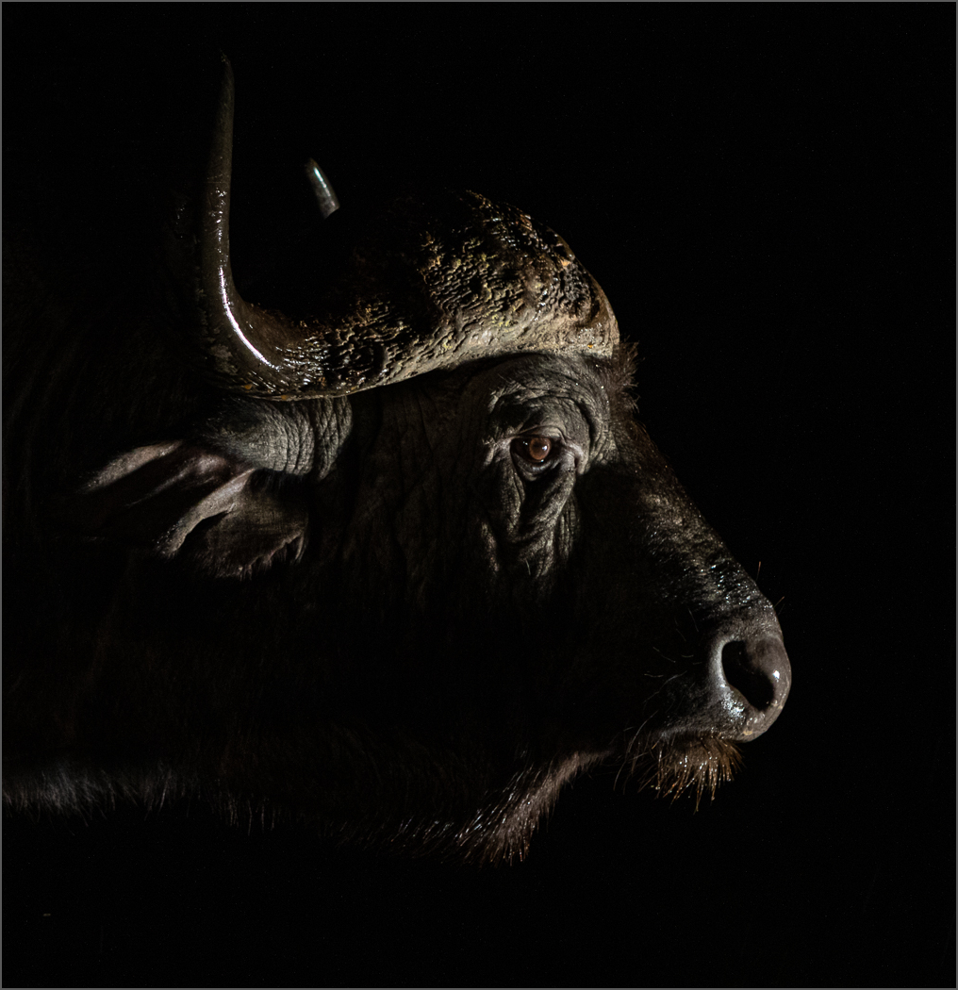
Teresa Hehir CPAGB
#10
BUFFALO PORTRAIT

Slide 38
The winners are:
In reverse order
#1 EARLY MORNING ROW

Slide 39
3rd place
#1 EARLY MORNING ROW

Slide 40
Hilary Pickersgill
#2
BLUE WAVE
#1 EARLY MORNING ROW

Slide 41
2nd place
#1 EARLY MORNING ROW

Slide 42
Jan Harris
ARPS, CPAGB
#3
WINTER IN ASSYNT

Slide 43
Winner of the
Jack Wilson cup
#1 EARLY MORNING ROW

Slide 44
Teresa Hehir CPAGB
#1
SQUACCO HERON
#1 EARLY MORNING ROW

Slide 45
congratulations
Teresa Hehir CPAGB – Margaret Beer Trophy for Best Wildlife
Winner
Jack Wilson Cup for Best Projected Digital Image with Squacco Heron
Jan Harris ARPS, CPAGB – Stan Holbrook Trophy for Best Landscape
2nd in the
Best Projected Digital Image with Winter in Assynt
Hilary Pickersgill – Castle Cup for Best Creative
3rd in the
Best Projected Digital Image with Blue Wave

Slide 46
Congratulations
To
Everyone
Who entered
Without you there would be no competition

